Slide 1

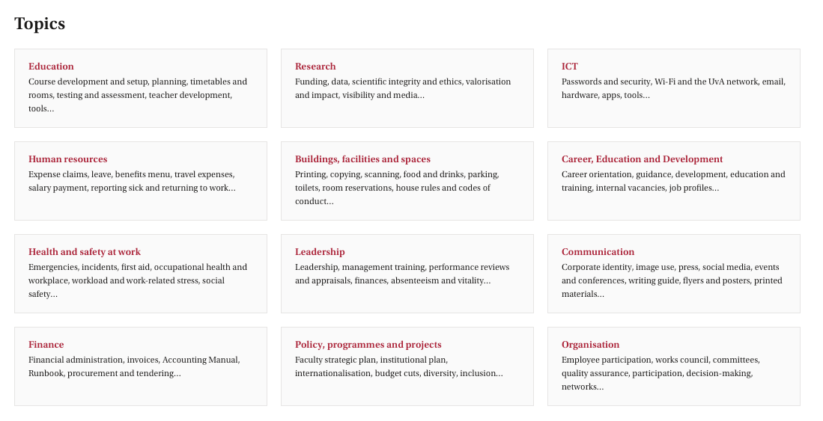
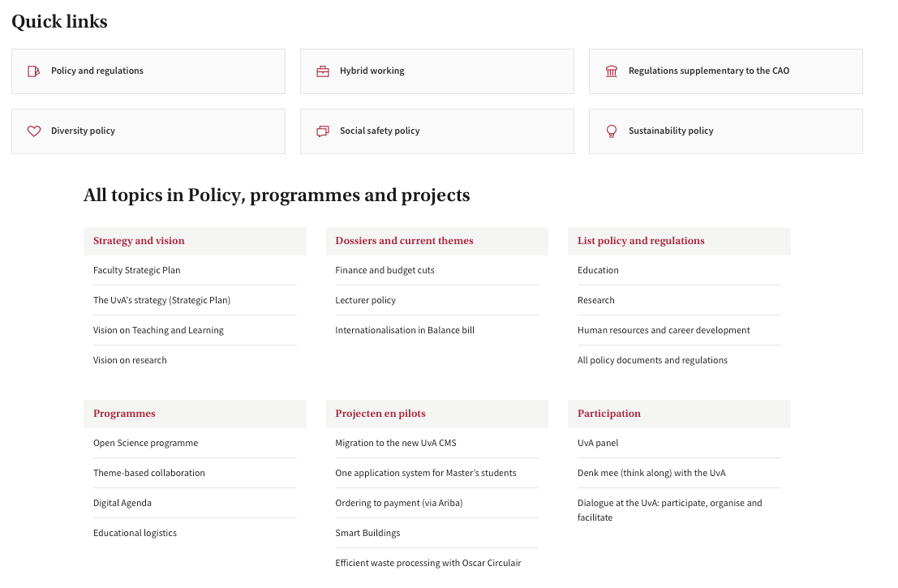
Faculty policy on use of LLMs/AI in research
https://medewerker.uva.nl/en
0.54 m €
0.40 m €

Slide 2
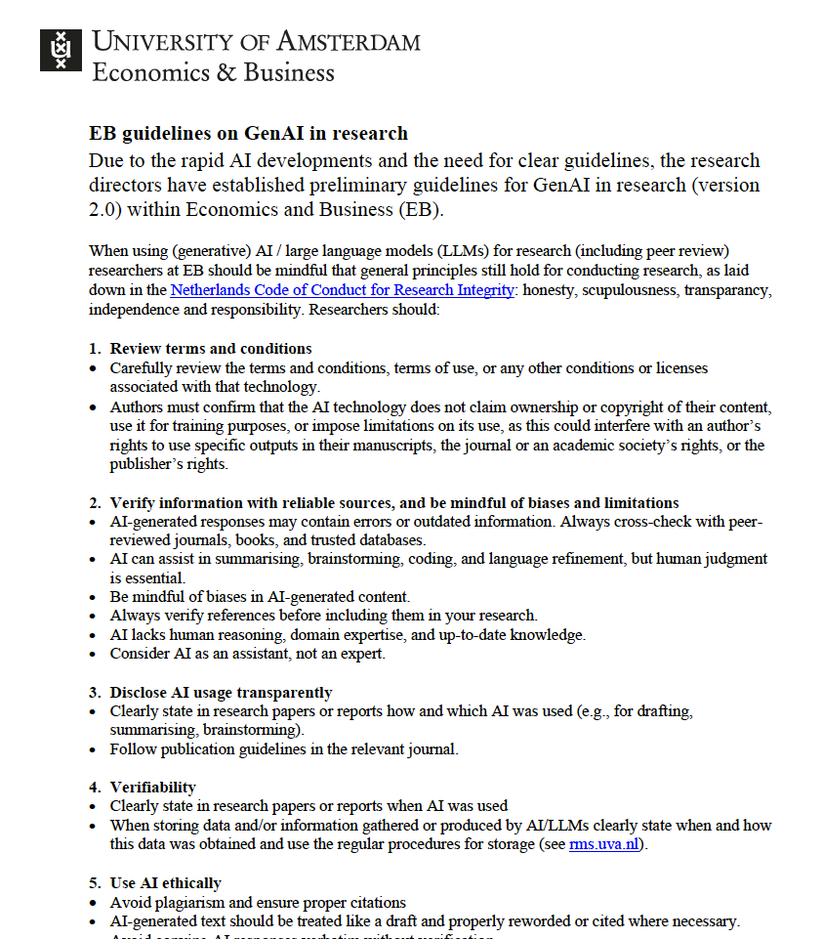
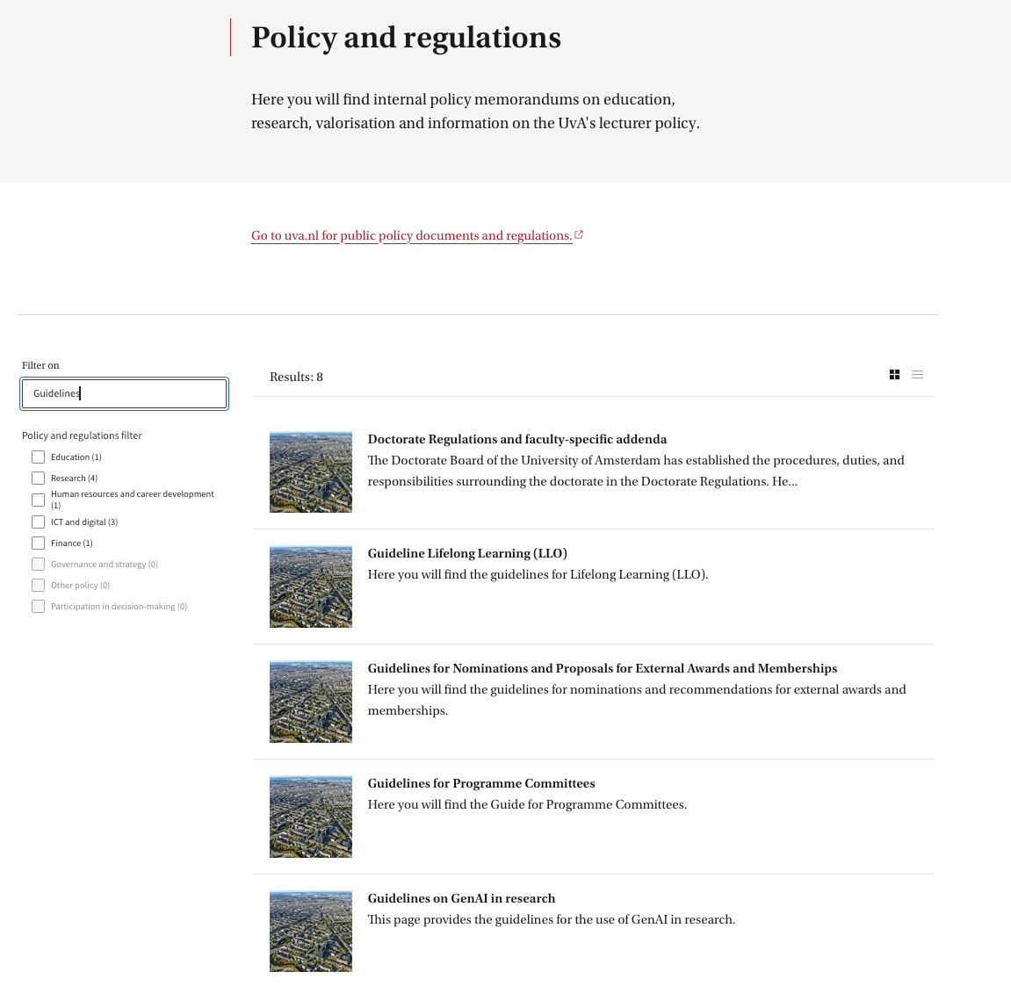
Faculty policy on use of LLMs/AI in research
https://medewerker.uva.nl/en
0.54 m €
0.40 m €

Slide 3
Faculty policy on use of LLMs/AI in research
1. Review terms and conditions
2. Verify information with reliable sources, and be mindful of biases and limitations
3. Disclose AI usage transparently
• Follow publication guidelines in the relevant journal.
4. Verifiability
5. Use AI ethically
6. Protect sensitive data and privacy
7. Be mindful of energy use
8. Guide junior researchers (or should it be the other way around?)
0.54 m €
0.40 m €

Slide 4
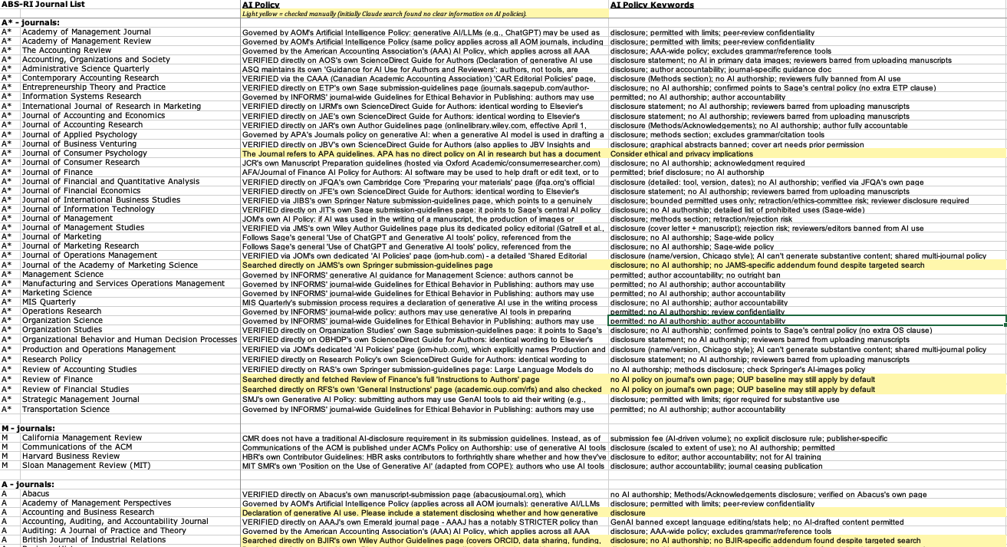
Journal policies on the use of AI – ABS journal list update
0.54 m €
0.40 m €
https://abs.uva.nl/research/research-policy-ethics--integrity/research-policy-ethics--integrity.html#Research-publication-criteria

Slide 5
General overview
Publisher default vs. field-specific rules. Most journals (about 80 of the ~261, plus many of the "verified" ones) simply inherit their publisher's boilerplate policy rather than writing their own: no AI authorship, a disclosure statement naming the tool and its purpose, and full author accountability for accuracy. This holds across Elsevier, Wiley, Sage, Springer, and Taylor & Francis alike. But a meaningful minority of journals layer something stricter or more specific on top, and this tends to cluster by discipline rather than being random. Accounting journals were consistently the strictest and most detailed — the AAA's umbrella policy, Contemporary Accounting Research's outright ban on reviewers using AI at all, and Accounting, Auditing & Accountability Journal's ban on AI-drafted content (copy-editing only) all point to a field that treats AI in the writing/review pipeline as a research-integrity risk first. Operations management stood out differently: five journals (JOM, POM, Decision Sciences, IJOPM, Journal of Business Logistics) turned out to share one detailed, jointly-authored policy that explicitly separates permitted uses (language help, literature classification) from banned ones (AI generating "substantive content" like theories or findings) — a rare case of journals coordinating across editorial boards rather than each just adopting their publisher's default.
Finance was the biggest outlier in the other direction. The Oxford University Press / Society for Financial Studies cluster (Review of Finance, Review of Financial Studies, Review of Asset Pricing Studies, Review of Corporate Finance Studies) and the "With Intelligence" boutique-journal family (Journal of Portfolio Management, Journal of Fixed Income, Journal of Derivatives) were consistently silent on AI at every level I could check — not even a pointer to a general publisher policy. That's not a gap in my research so much as a genuine feature of that corner of finance publishing; it's worth knowing before assuming a disclosure requirement exists there. Elsewhere, individual journals occasionally diverged sharply from their own publisher's norm — Journal of Product Innovation Management requires a whole separate appendix of AI prompts and outputs, Public Administration Review specifically bans AI from touching research data (not just text), and Industrial and Corporate Change requires disclosure in two separate places — which suggests that for any journal you're actually submitting to, checking its own current page is still worth doing even when a publisher-level answer already exists.
Claude summary September 25, 2026 after prompt: “Can you write max 2-3 alinea's on your general findings and also reiterate some of the points you made after some of the prompts (e.g. how certain types of sub-fields have similar policies or lack of policies)?” after letting Claude check AI policies of all journals on the ABS journal list.
0.54 m €
0.40 m €

Slide 6
Policies by main publishers
Cambridge University Press Academy of Management
Elsevier American Accounting Association
Oxford University Press American Finance Association
Sage American Marketing Assocation -> Sage
Springer Nature American Psychological Assocation
Taylor & Francis INFORMS
Wiley
0.54 m €
0.40 m €

